Slide 1
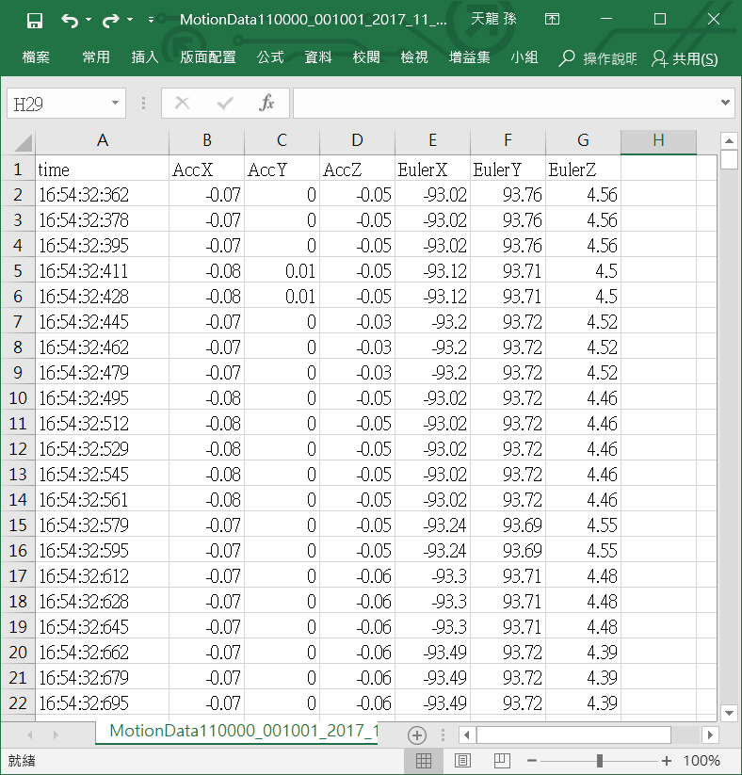
Read data in a CSV file to a data frame
df = pd.read_csv(fname,usecols=[1, 2, 3])

Slide 2
Convert data frame to tensor
3000 x 3

Slide 3
Read multiple csv files and generate input tensors
3000 x 3
3000 x 3
3000 x 3
N files
X = [N, 3000, 3]

